Slide 1

Library Management System

Slide 2

Desktop Application GUI

Slide 3
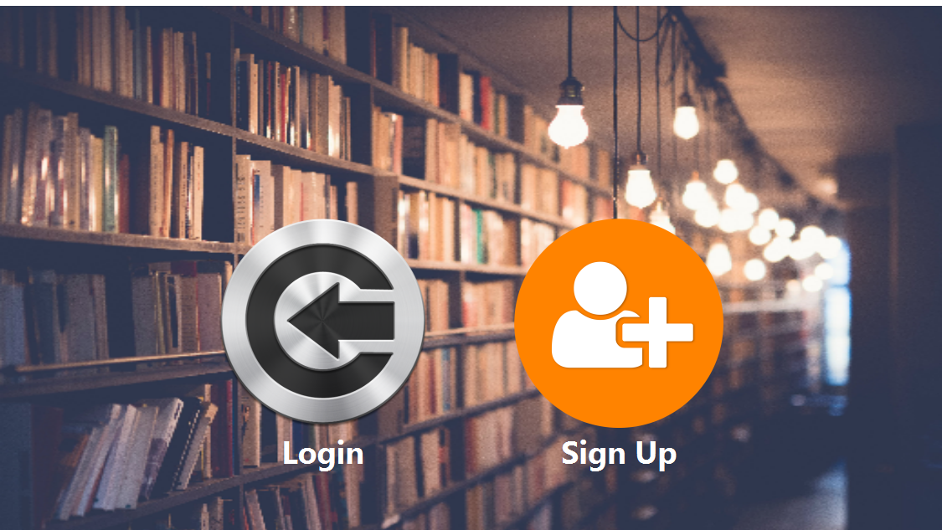

Slide 4
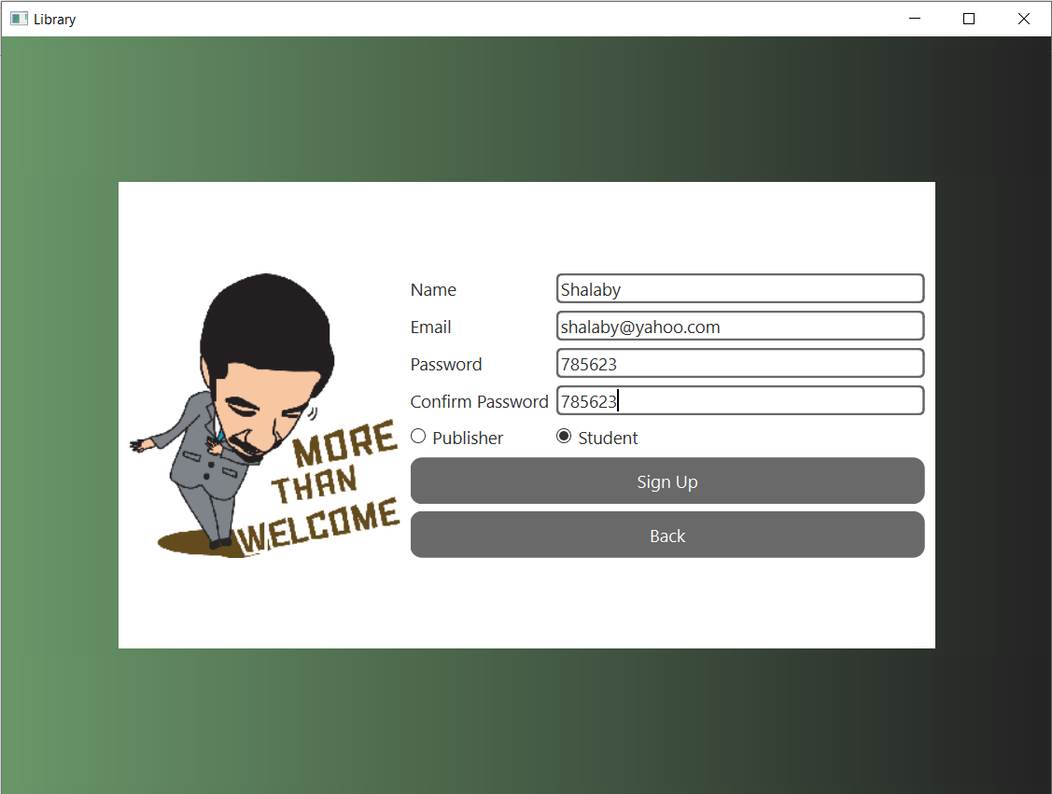
REGISTRATION

Slide 5
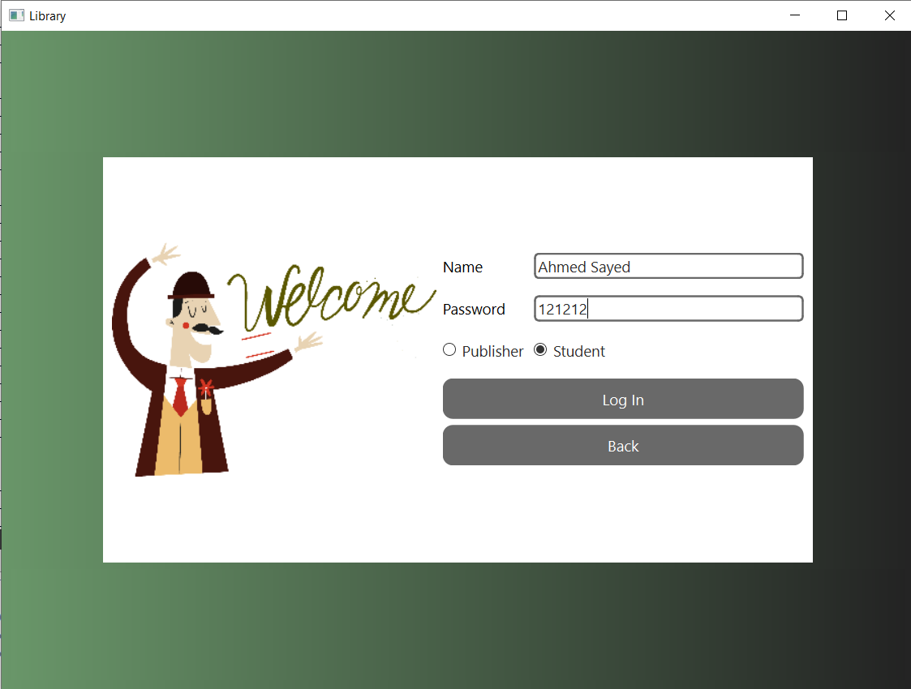
Account Available

Slide 6
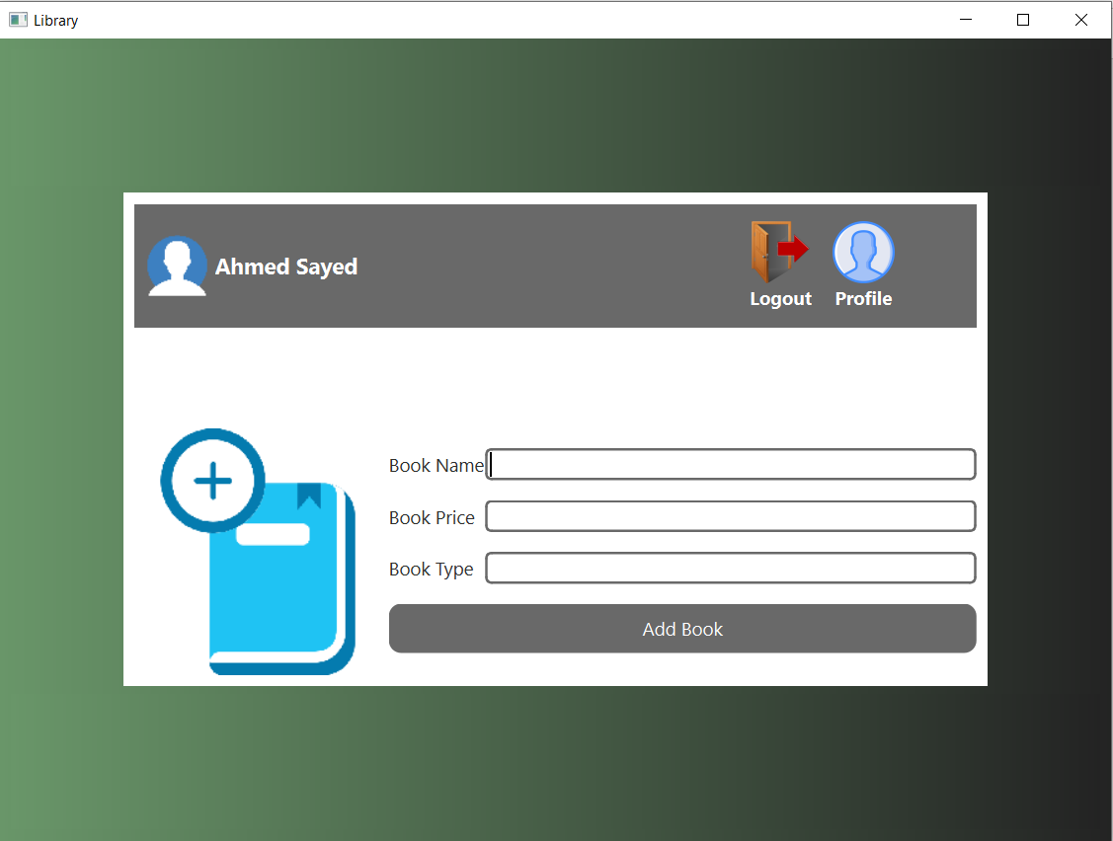
PUBLISHER ACCOUNT

Slide 7

ADD BOOK

Slide 8
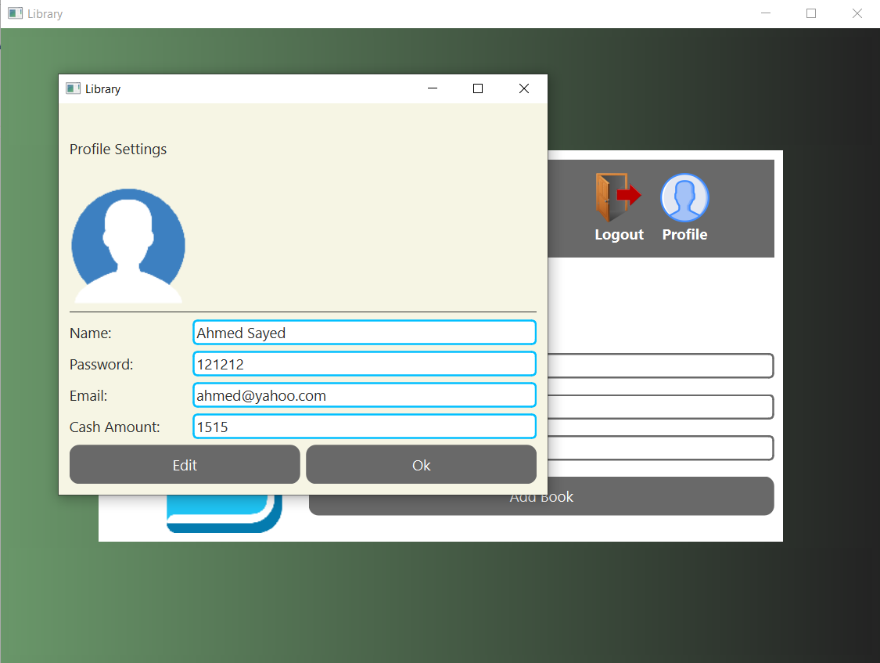
EDIT PUBLISHER PROFILE

Slide 9
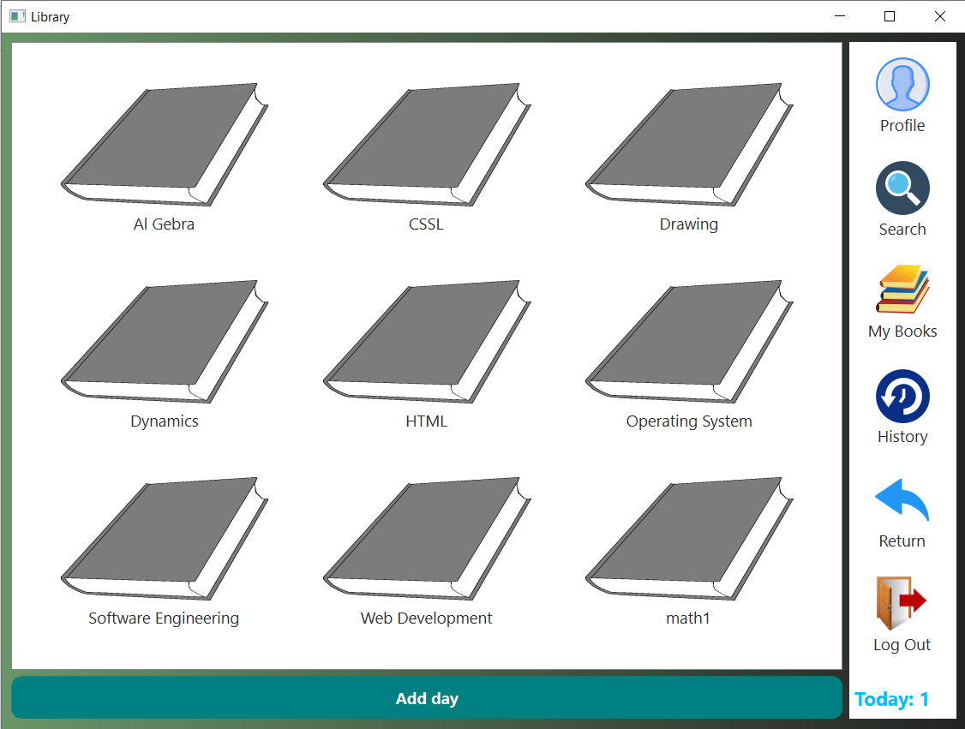
STUDENT ACCOUNT

Slide 10
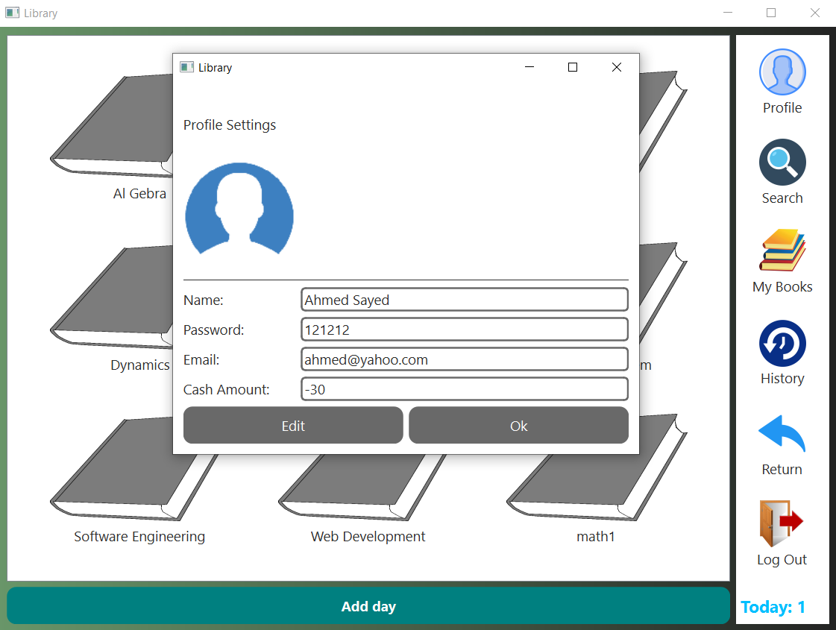
EDIT STUDENT PROFILE

Slide 11
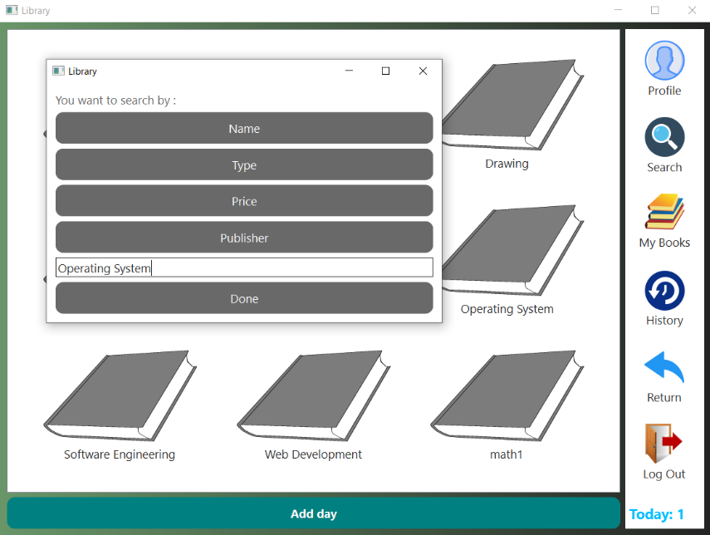
SEARCH

Slide 12
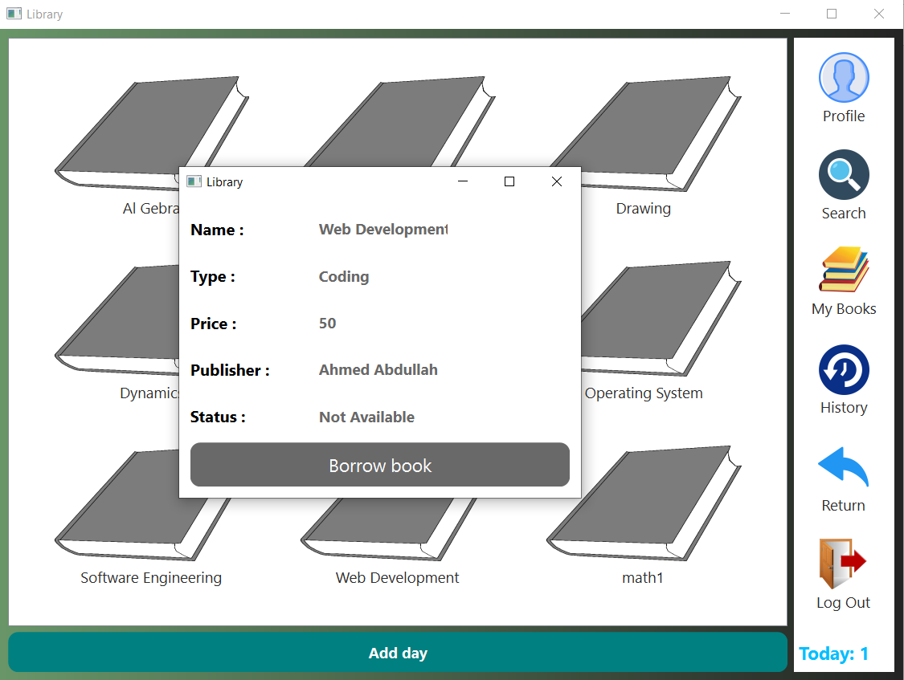
BORROW BOOK

Slide 13
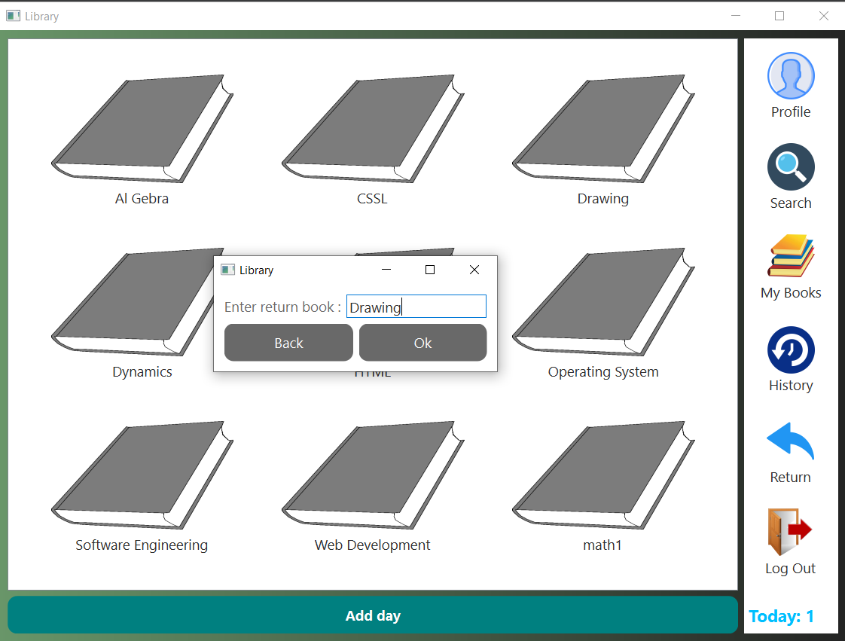
RETURN BOOK

Slide 14
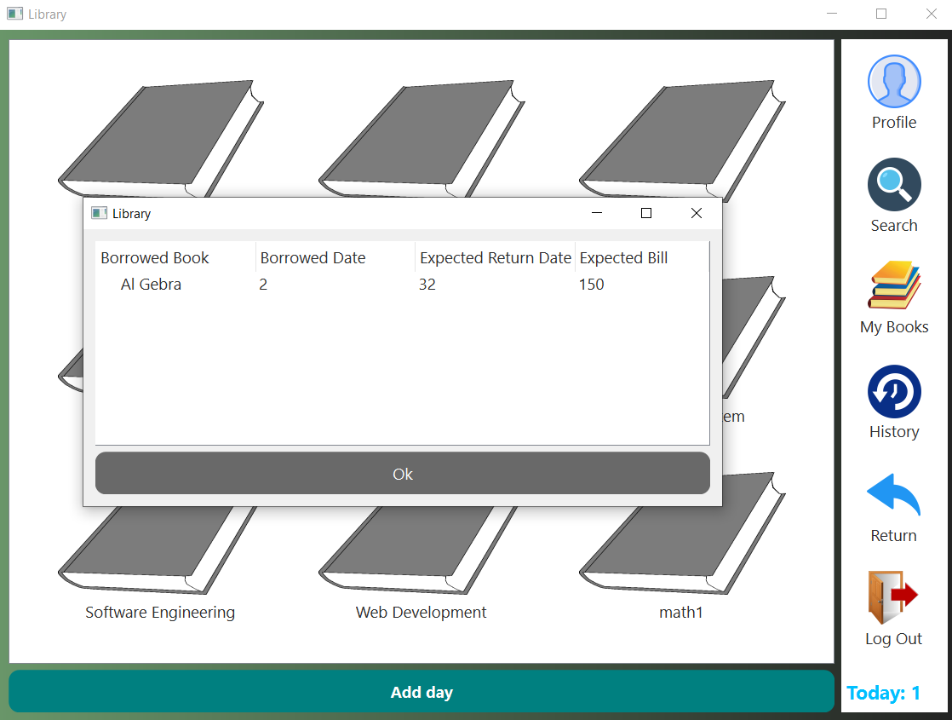
BORROWED BOOKS

Slide 15
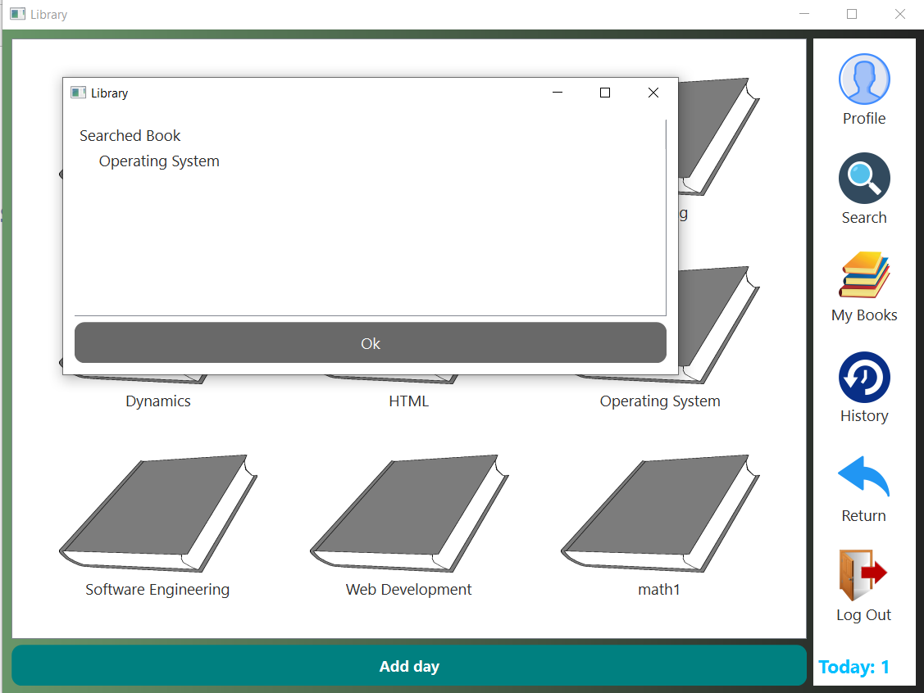
SEARCH HISTORY

